Slide 1
A Transaction Fee Market Exists Without a Block Size Limit*
Peter R
Montreal Scalability Workshop
September 12, 2015
*Provisos: (1) Inflation rate is nonzero
(2) More than one miner or mining pool

Slide 2
Miner’s Are Commodity Producers
Miners find the magic nonce
They also produce a new type of digital commodity called “block space”
What does Economics tell us about the production of a commodity?

Slide 3
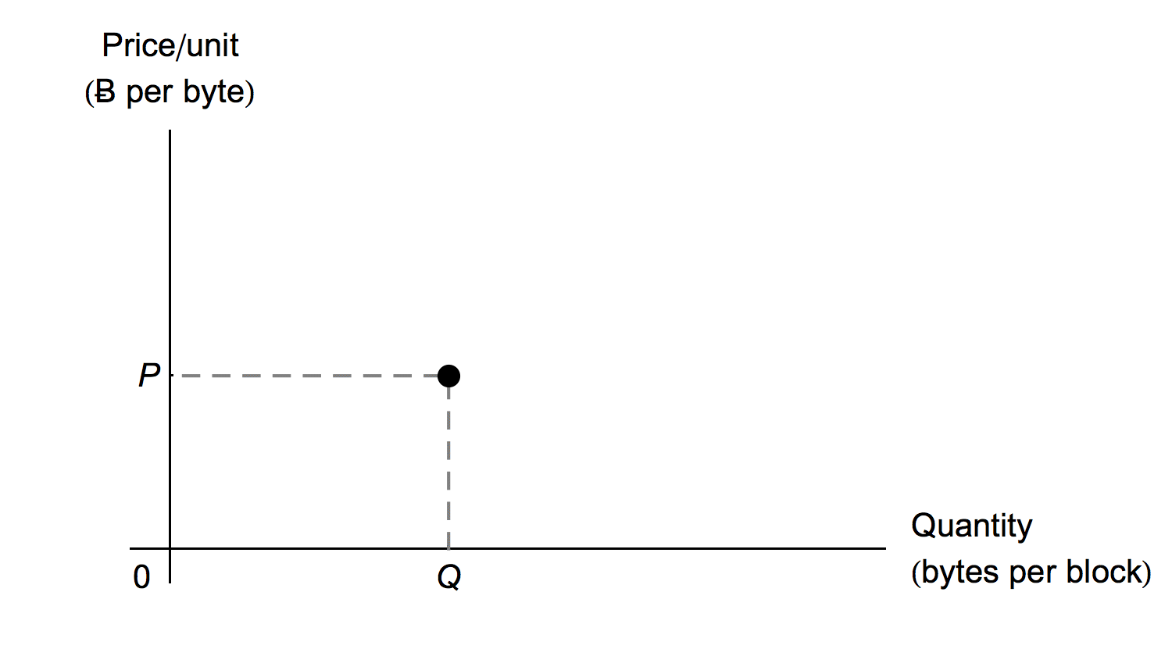
Total Quantity vs Unit Price

Slide 4
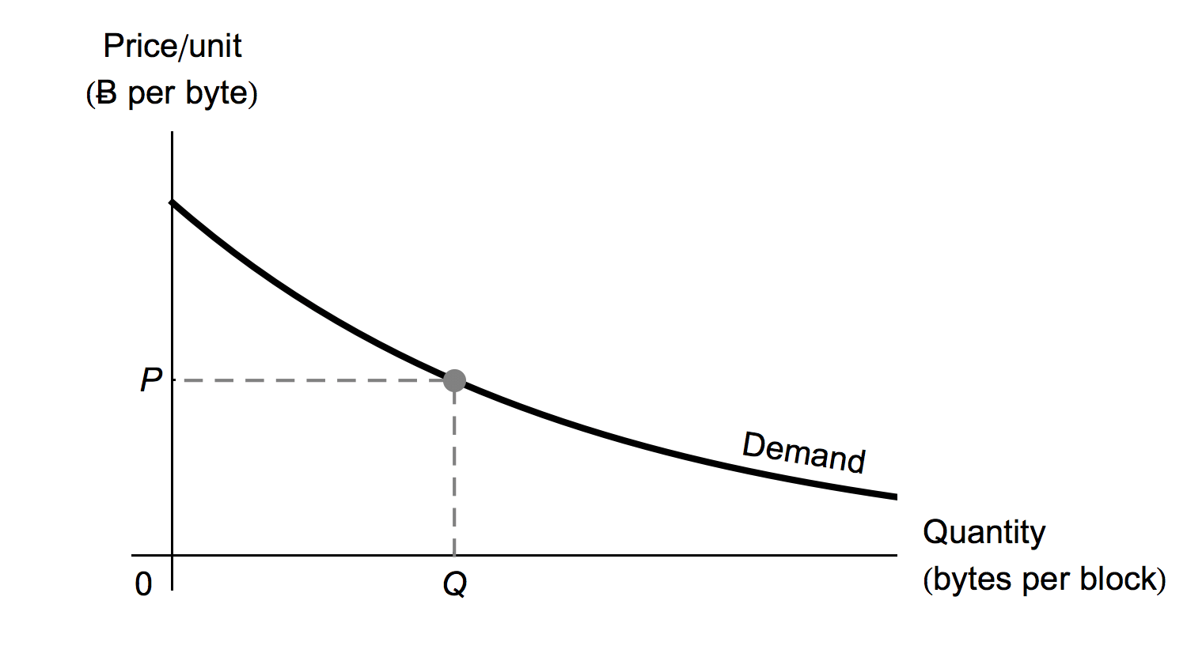
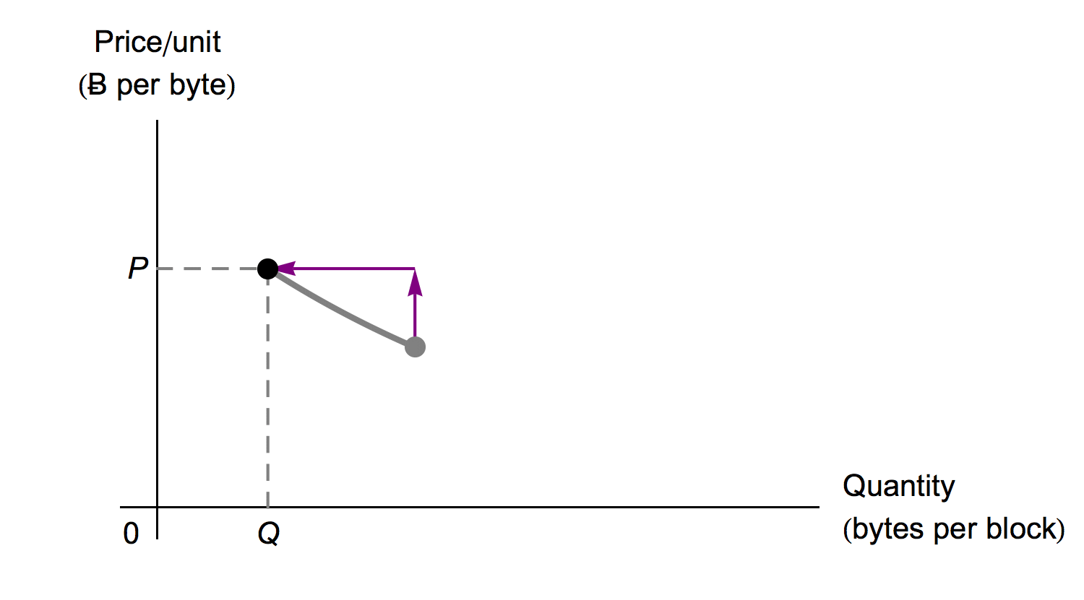
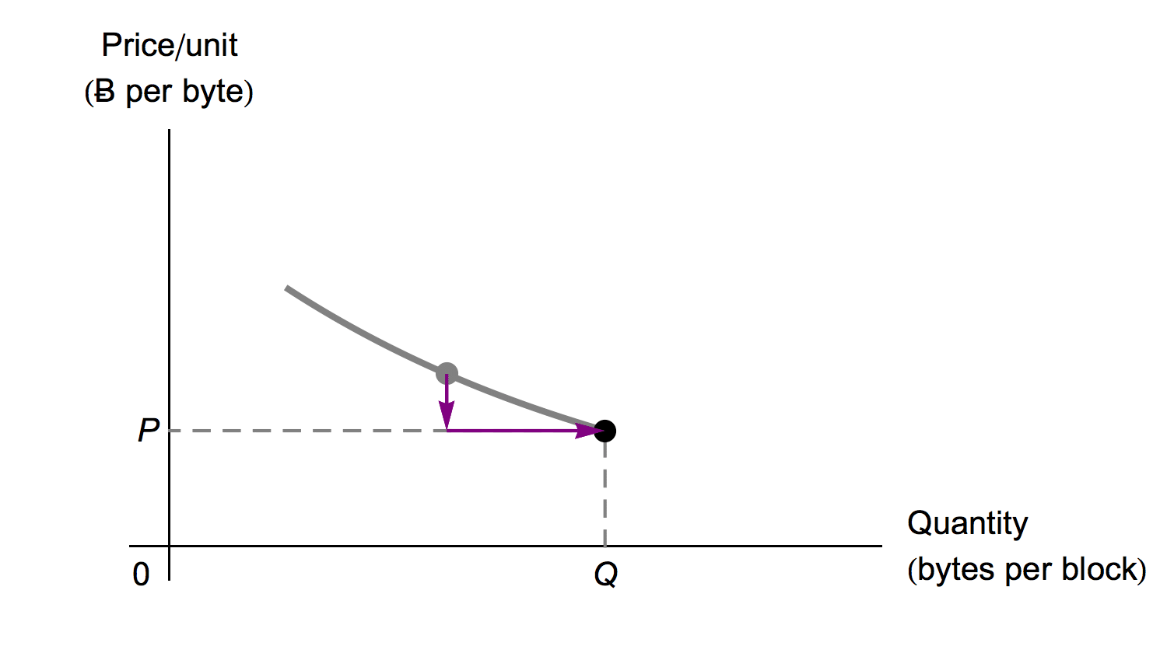
The Law of Demand
Demand can be considered infinite!
Sound familiar?
Economists struggled with this conundrum too…

Slide 5
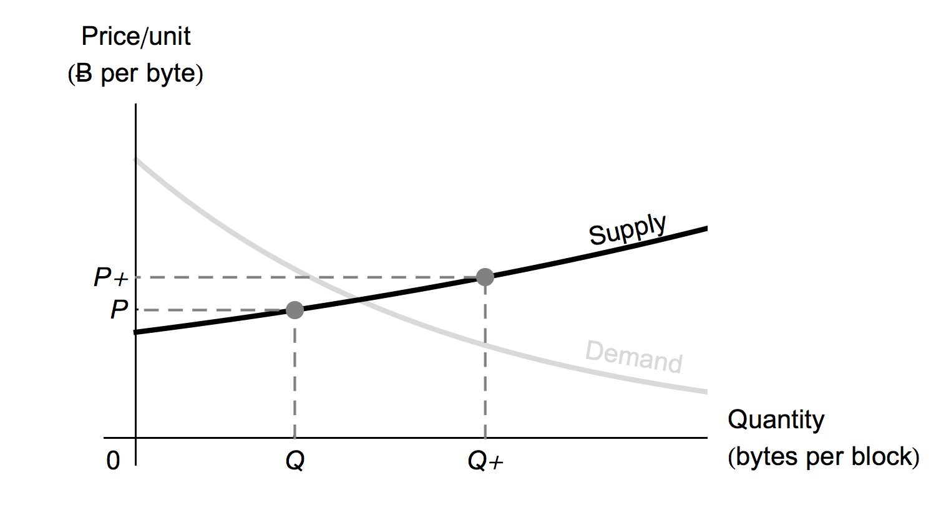
The Law of Supply

Slide 6
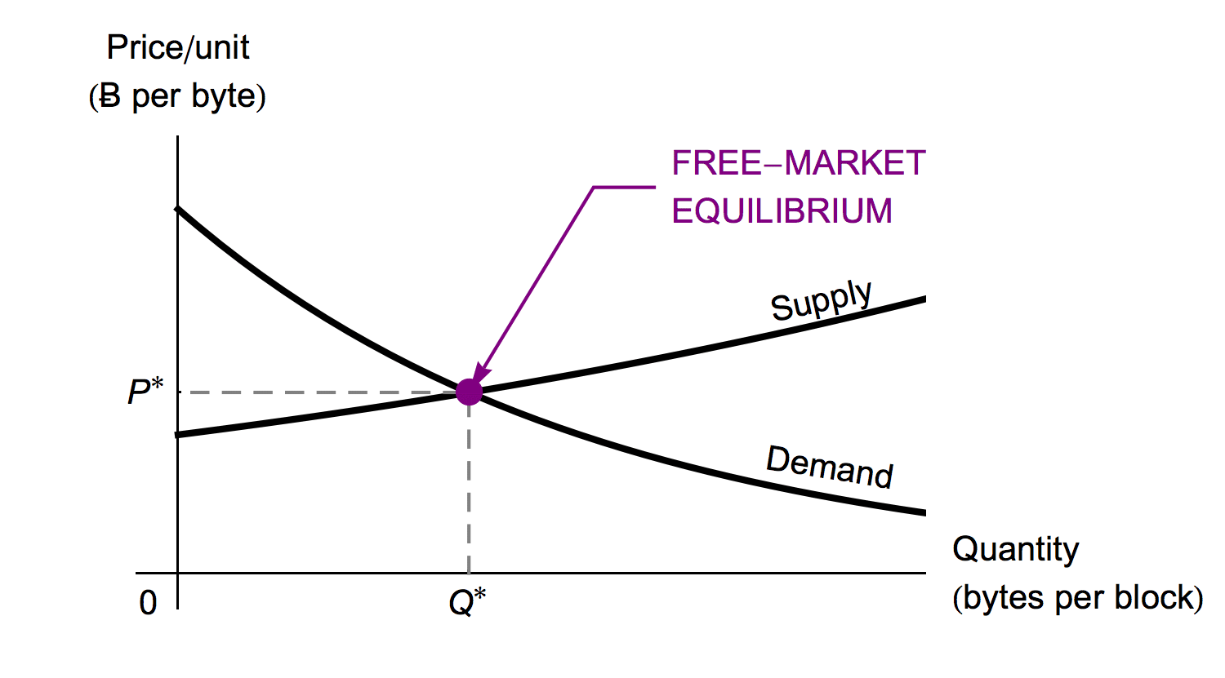
Supply & Demand
Finite quantity produced even though demand can be considered infinite.

Slide 7
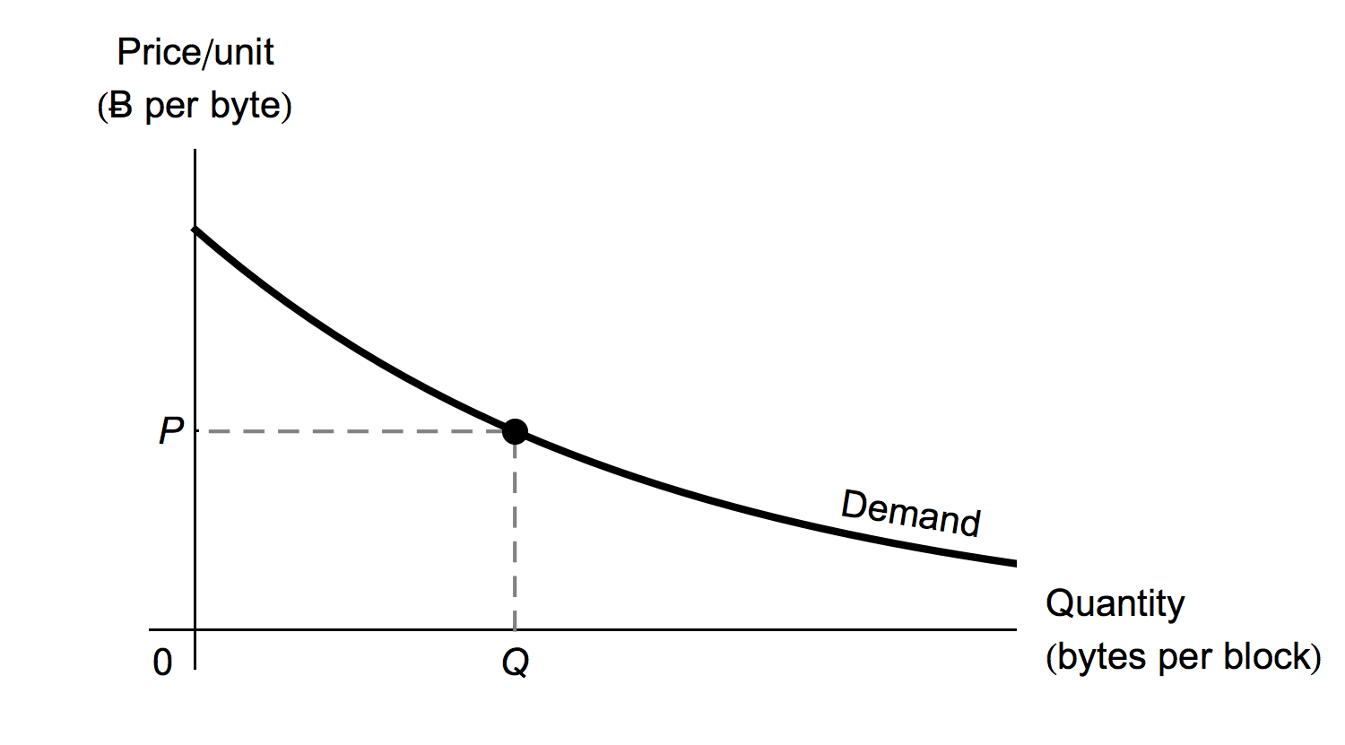
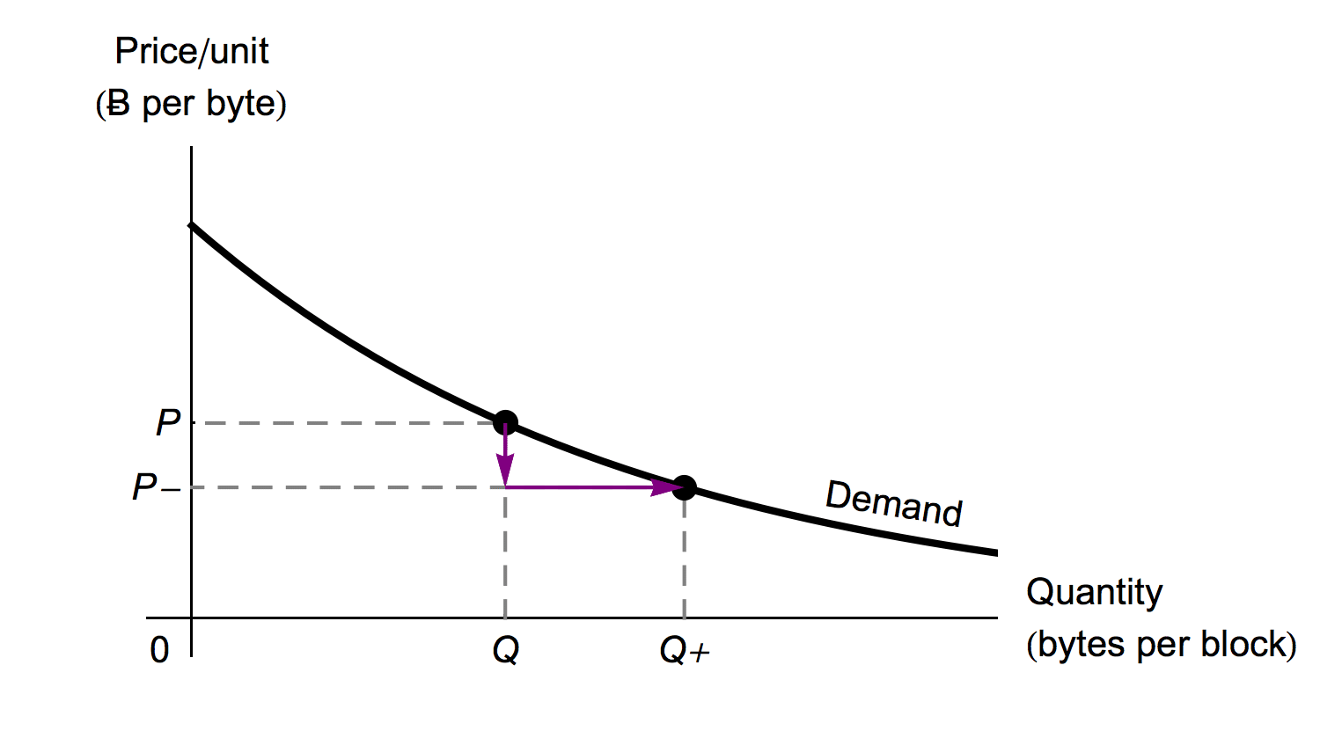
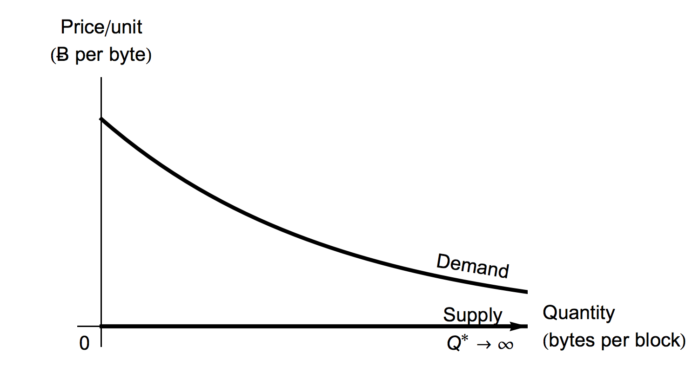
Block Space as a Normal Economic Commodity

Slide 8
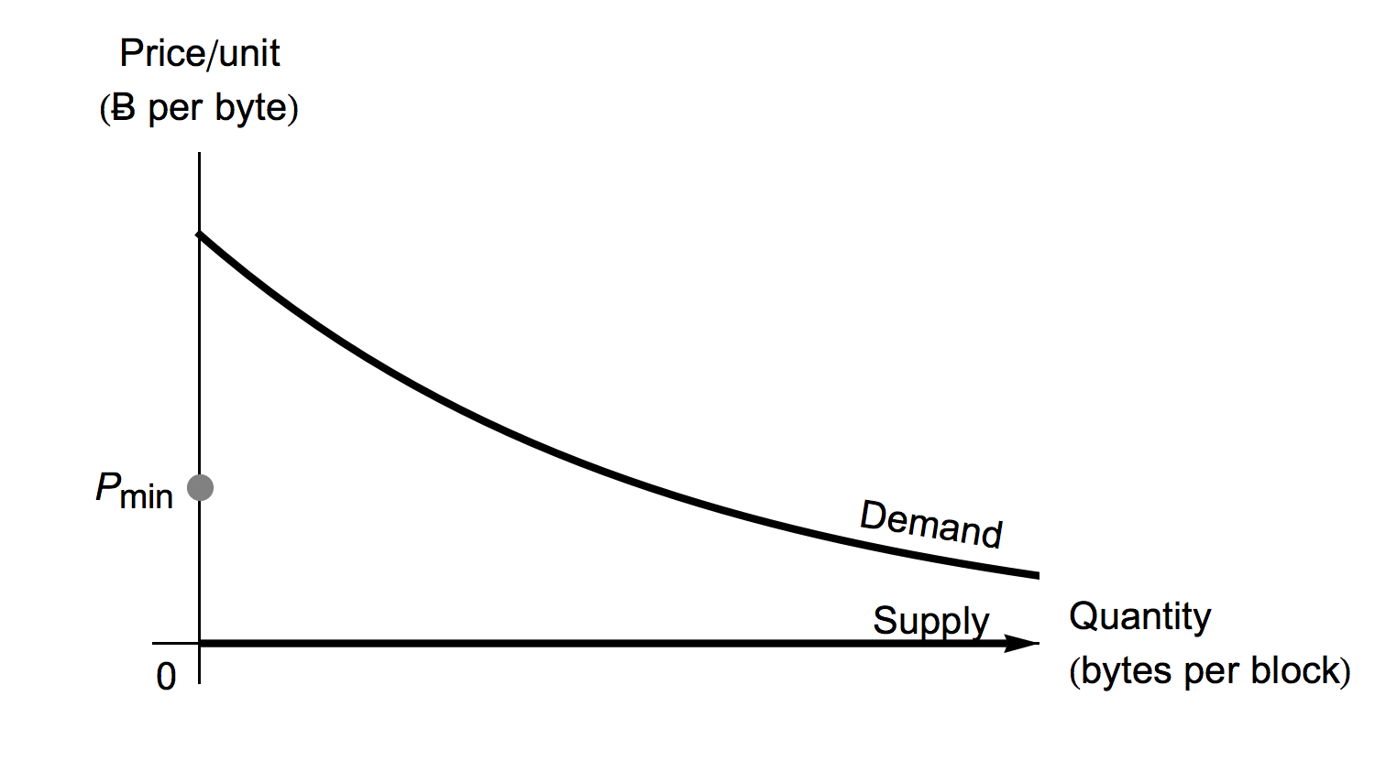
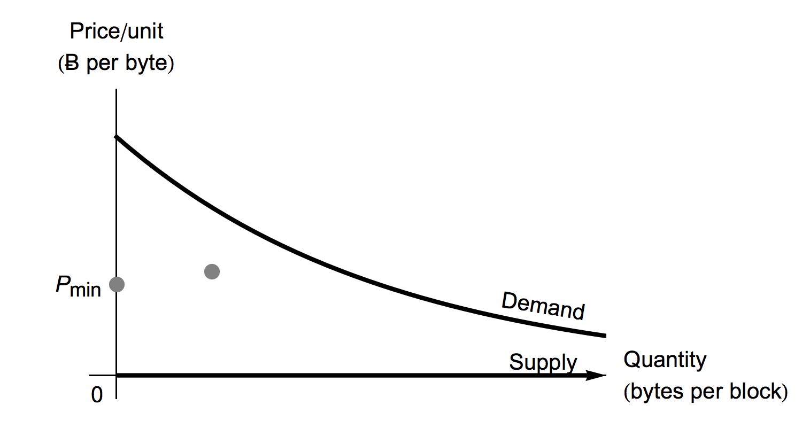
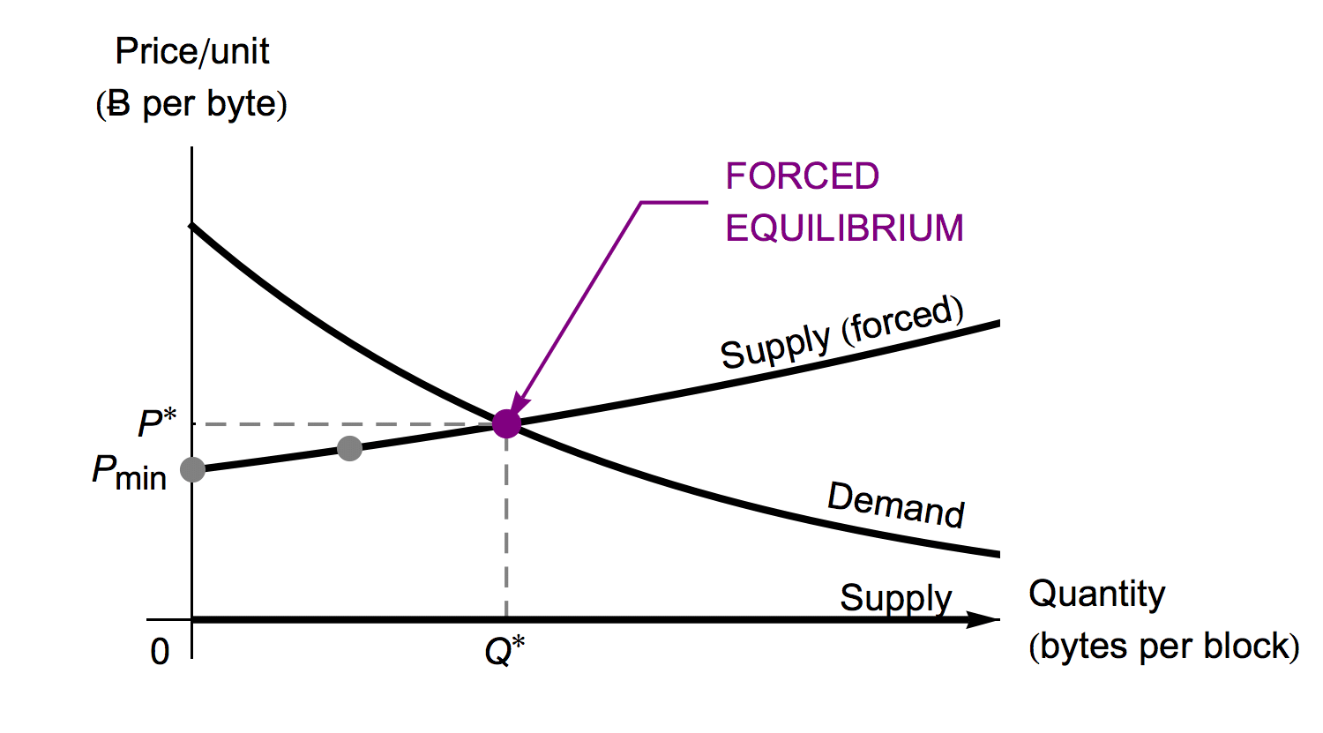
FlexCap Proposal

Slide 9
FlexCap Problems
Problems:
Centralized group decides “right price”
Also decides winners and losers
Fortunately we don’t need FlexCap due to orphaning…

Slide 10
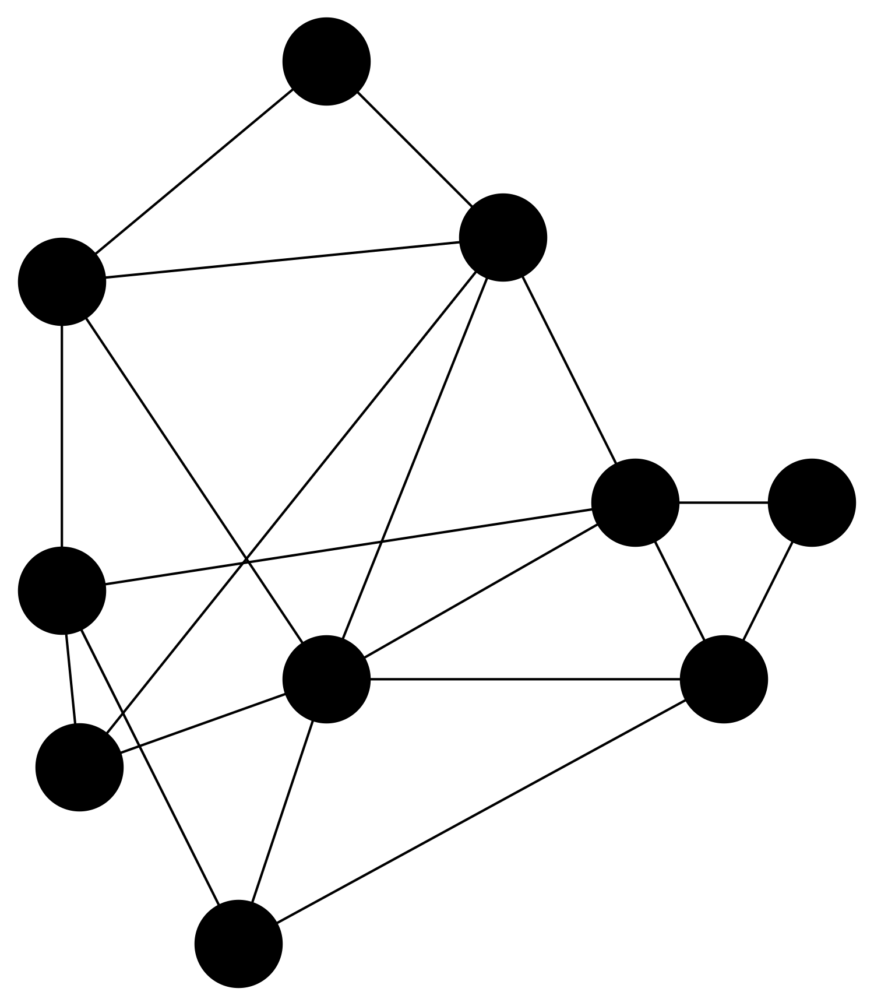
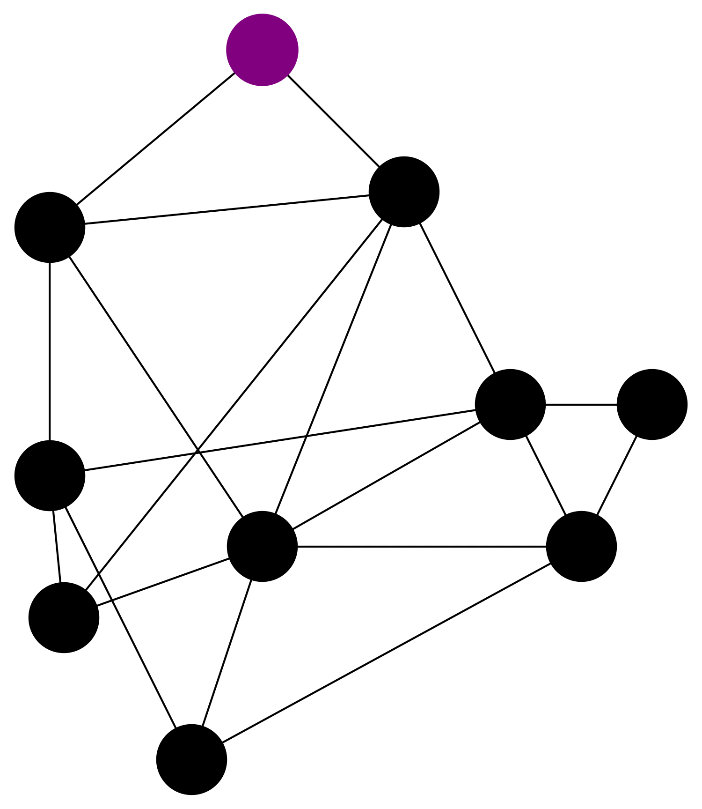
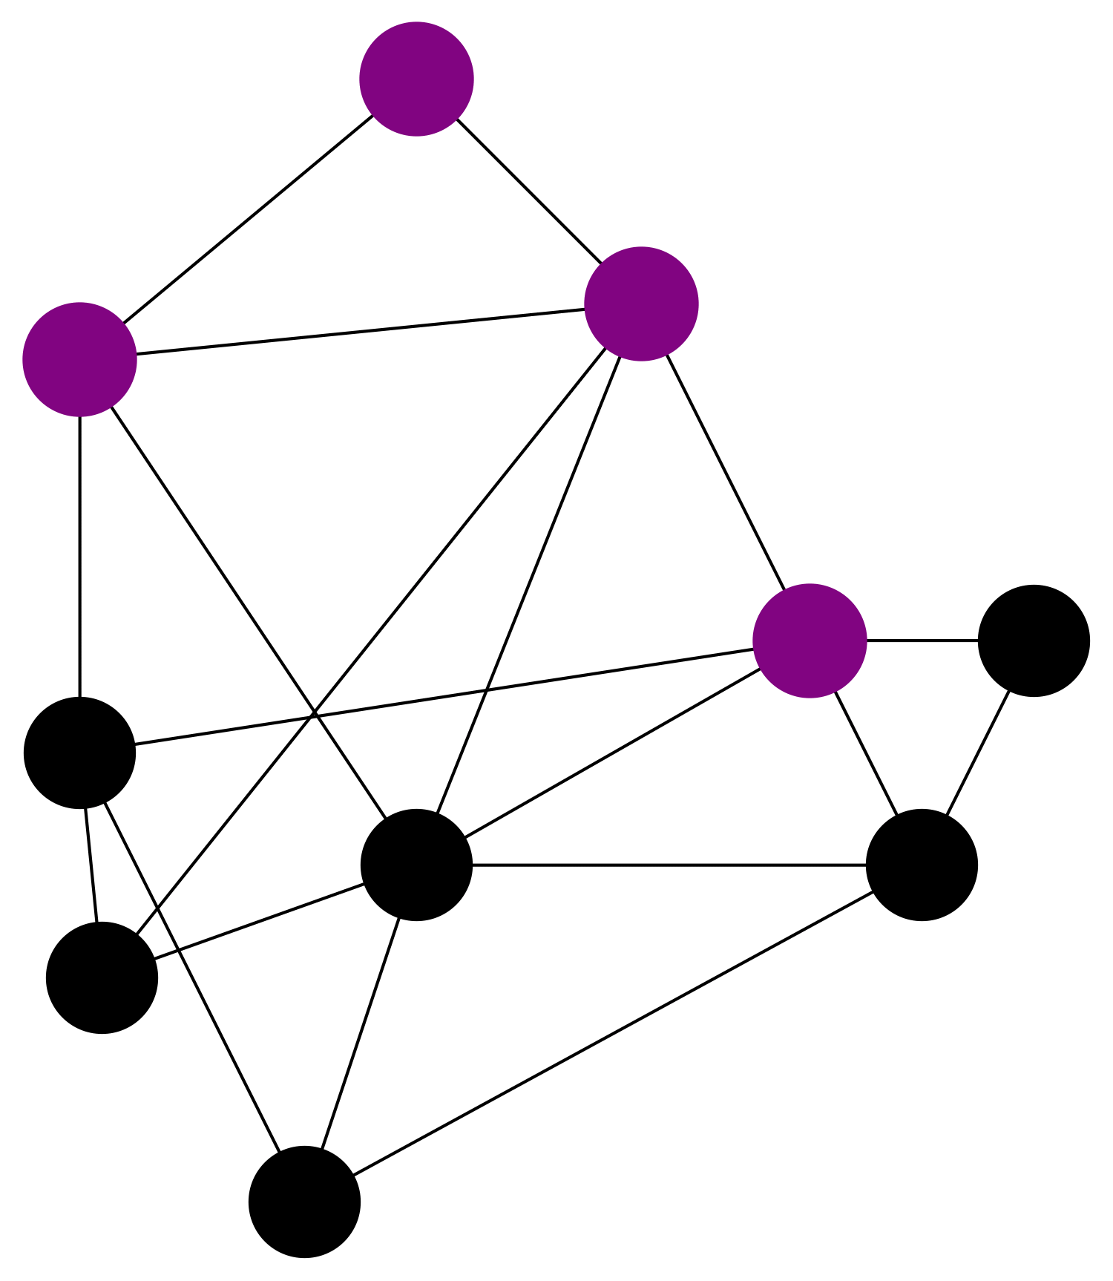
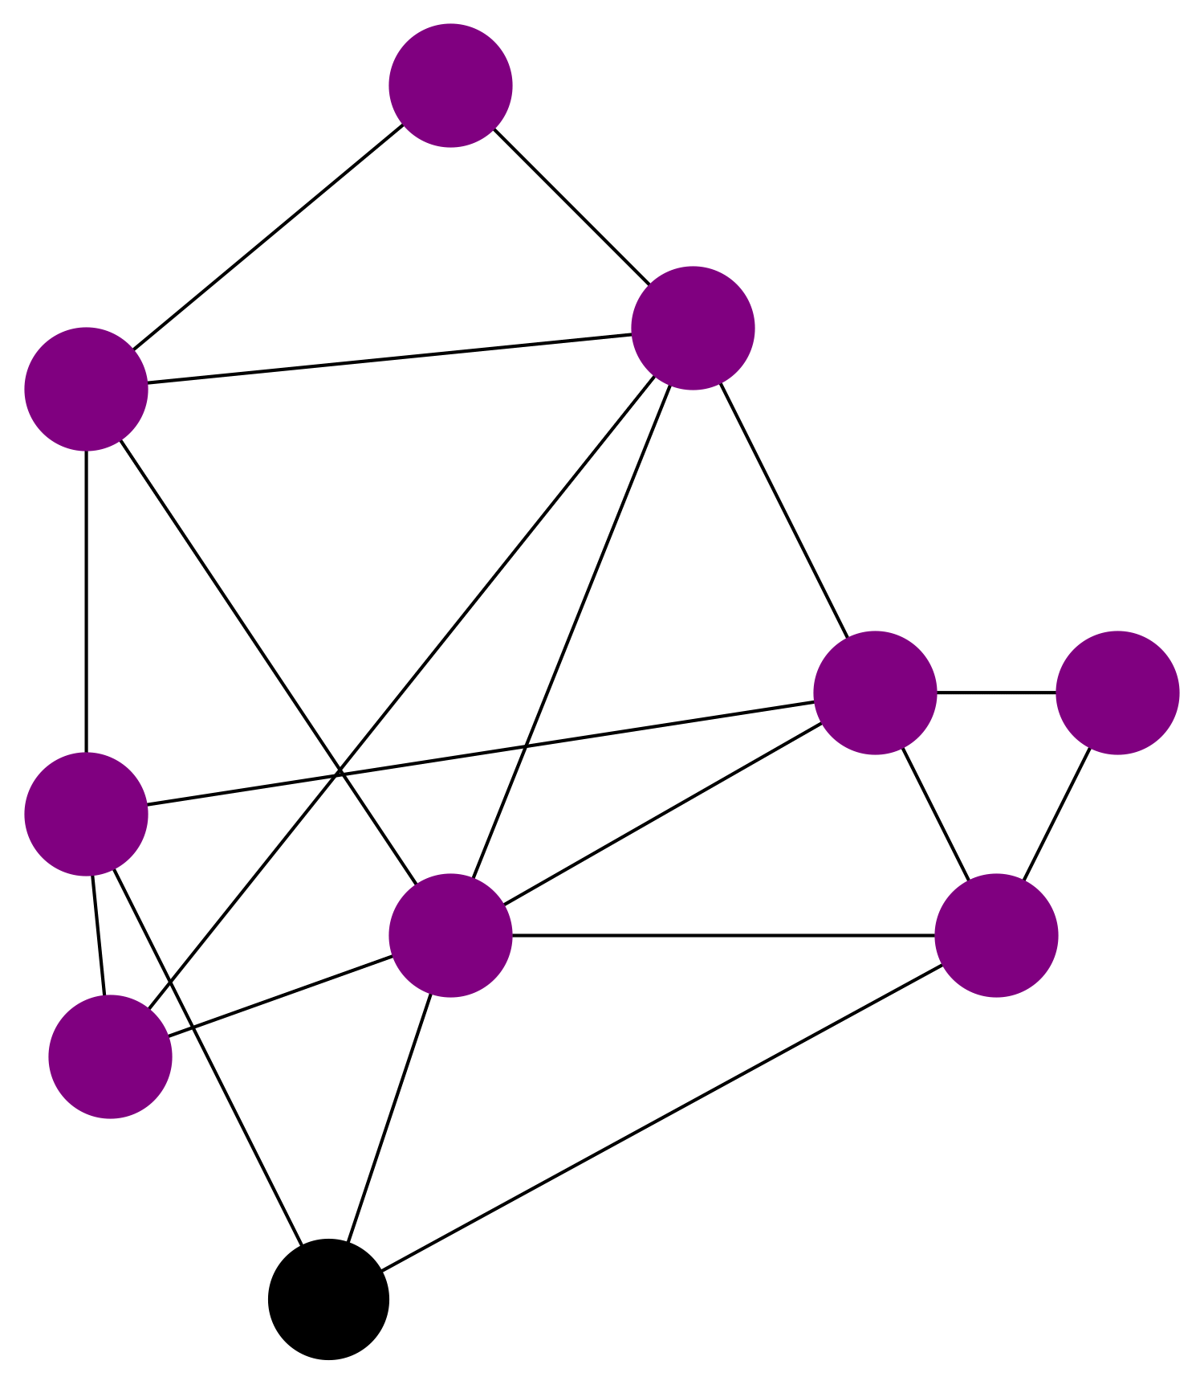
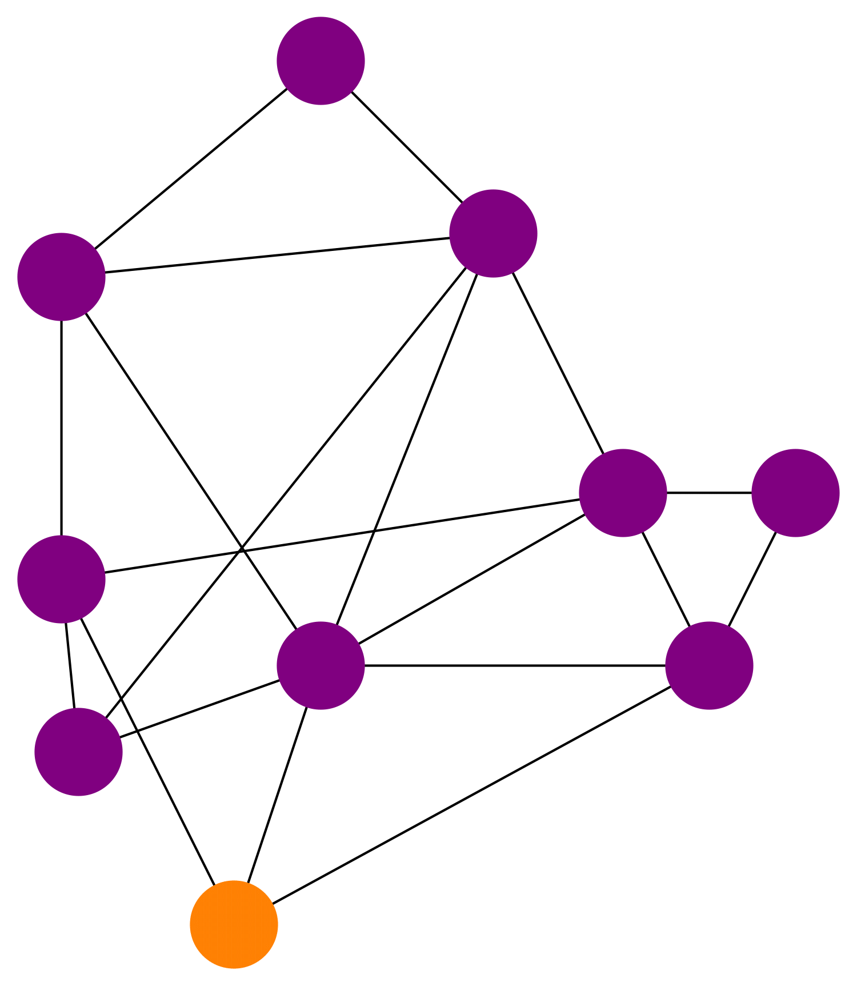
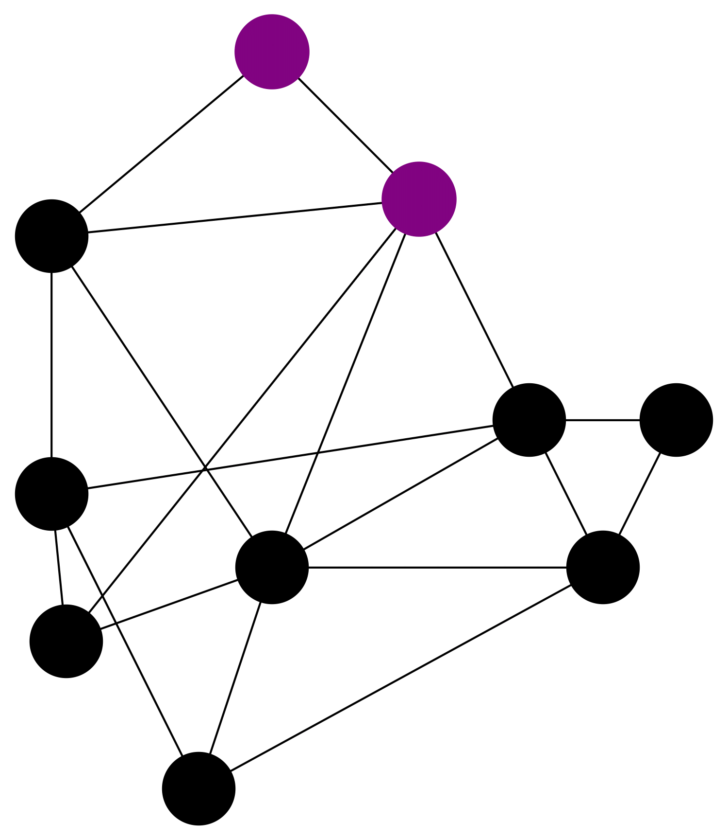
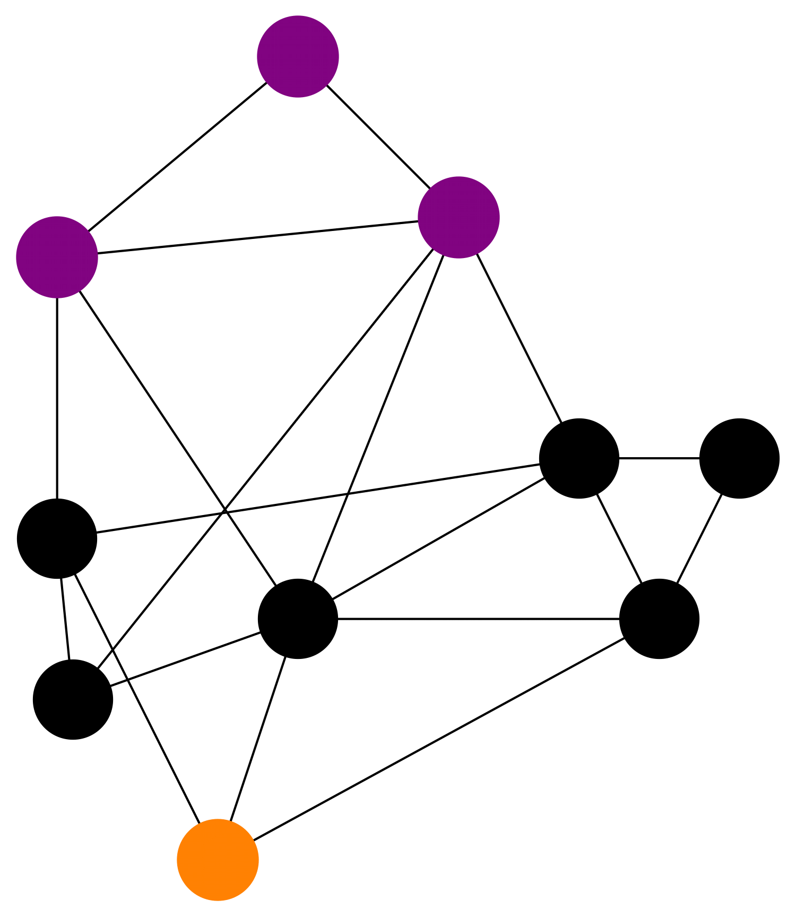
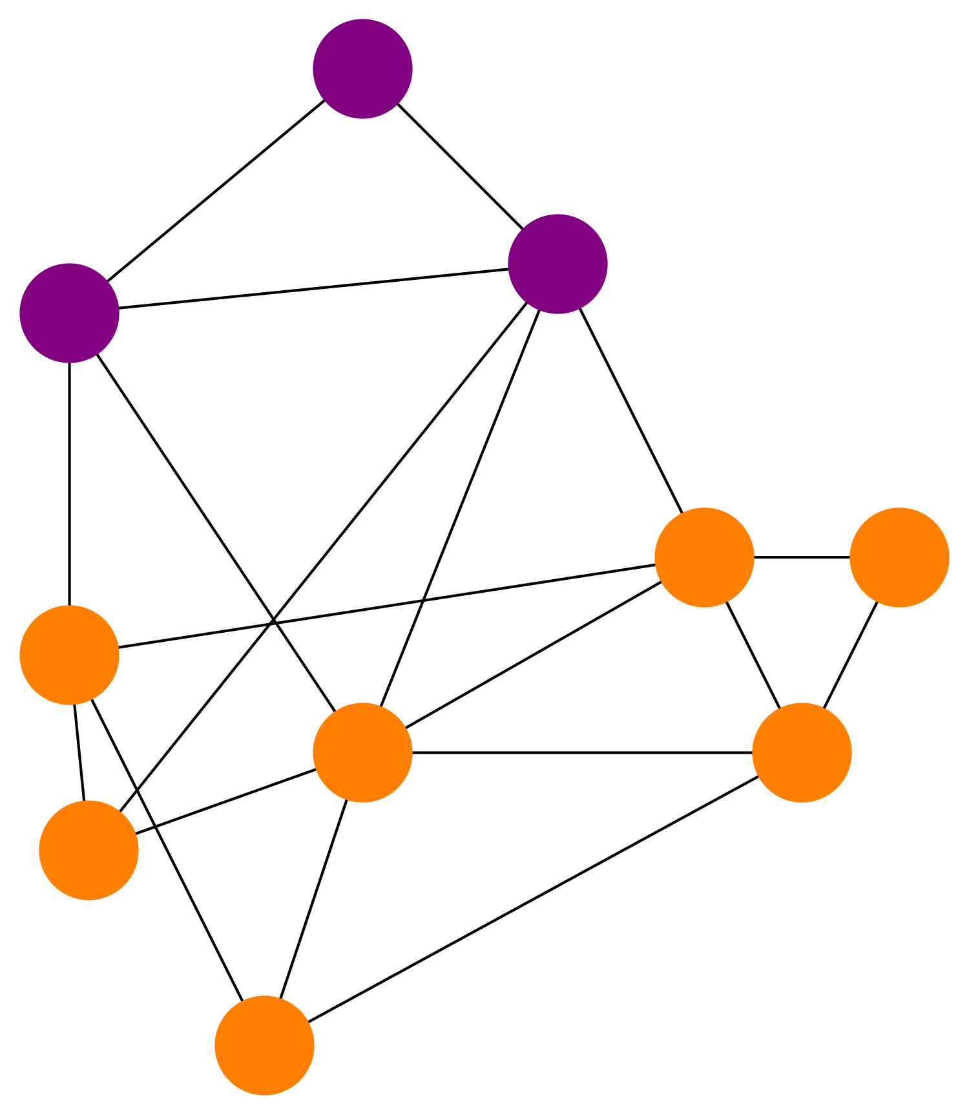
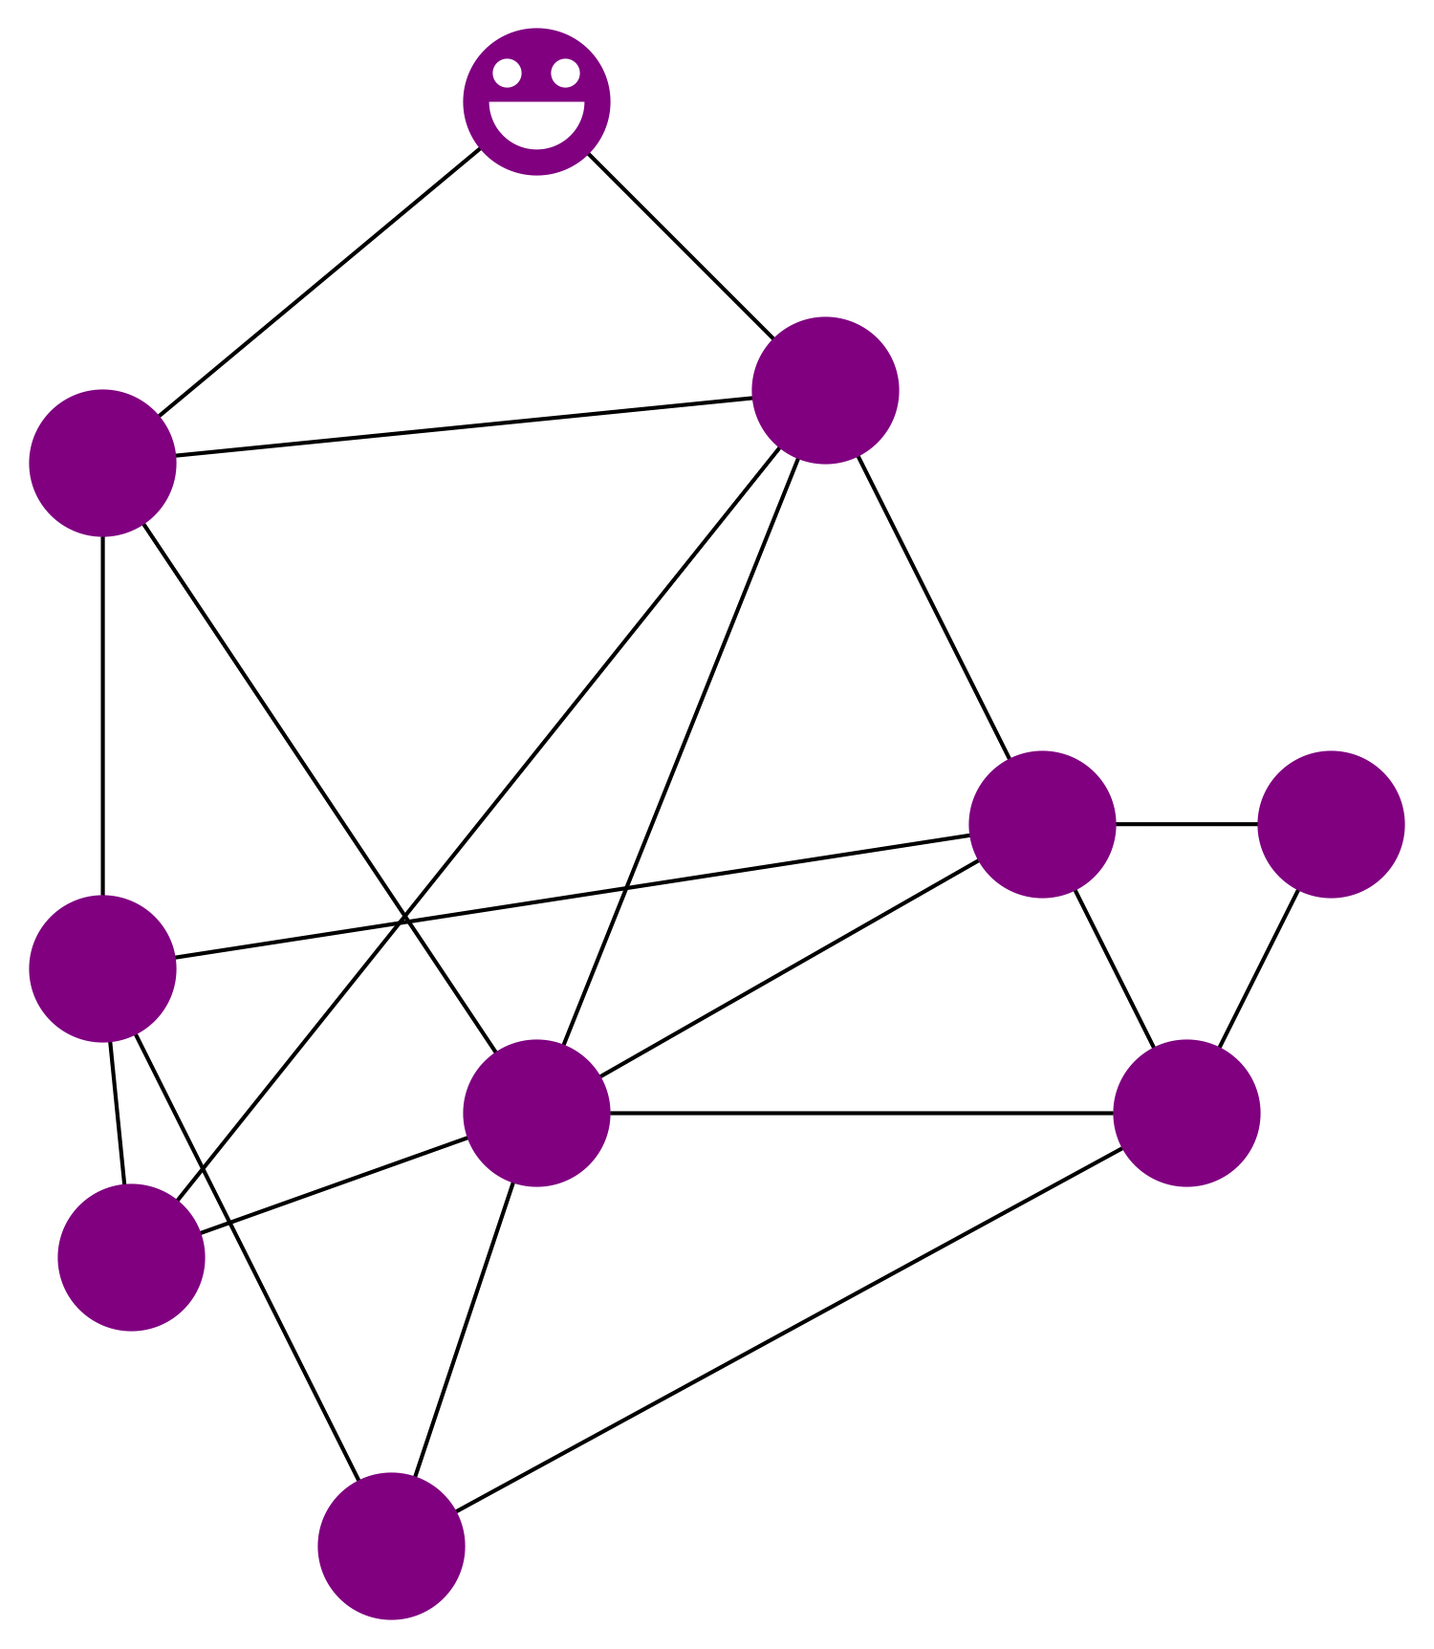
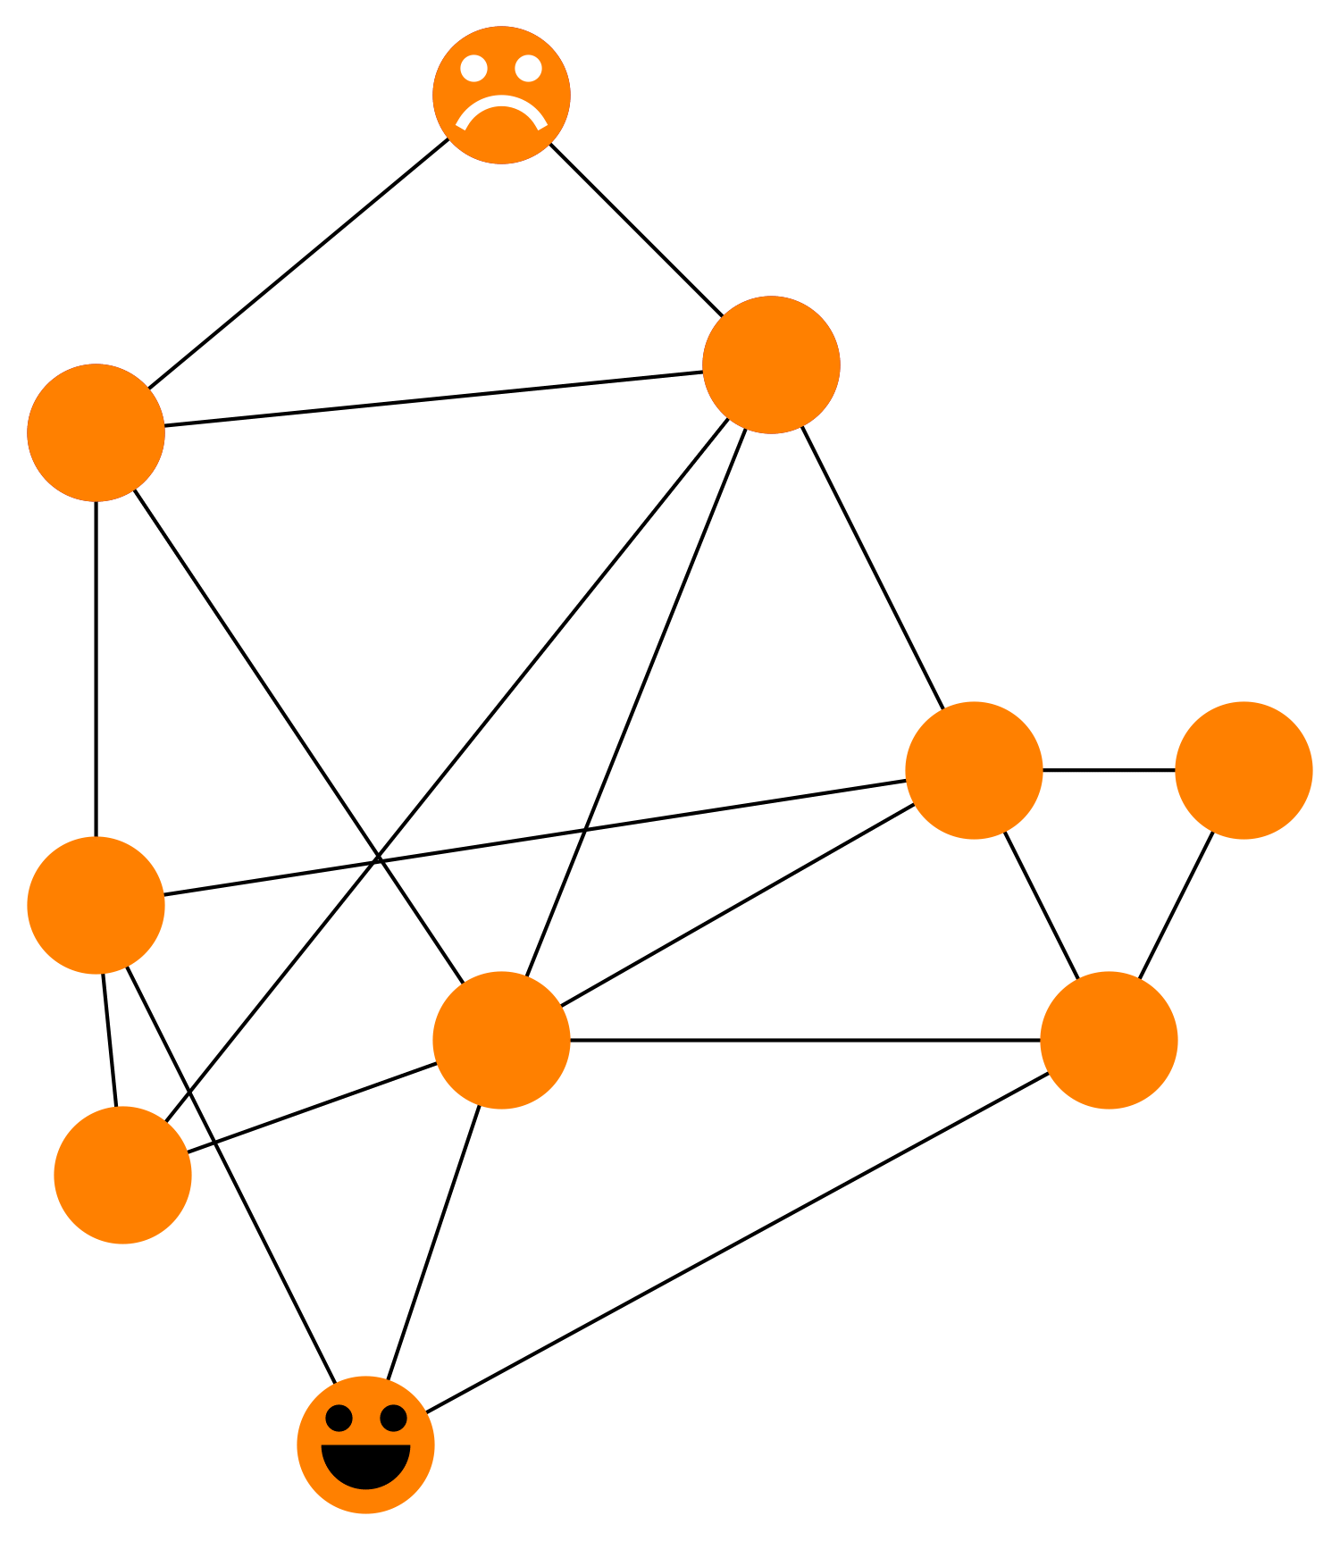
What is orphaning?
Normally a miner broadcasts his block and the others mine on top of it
If another block comes later, it is ignored
If his block is BIG it propagates slowly
Other miners think the small block came first
Miner loses reward
155 blocks orphaned in Q1, 97 in Q2; ~1% rate.

Slide 11
How Orphaning Affects The Miner’s Cost of Production for Block Space
<Revenue> =
(Reward + Fees)
Miner’s hash rate
Network hash rate
e ^{-(Propagation time)}
Miner chooses balance between fees and orphaning risk to maximize profit
With a bit of algebra and calculus, it follows that:
Proviso #1
Cost per byte ~ (inflation rate) e ^{+(Propagation time)}
Shannon-Hartley theorem: communication time ~ information communicated
Cost per byte ~ (inflation rate) e +(Propagation impedance)(Block size)
Exponential in block size!

Slide 12
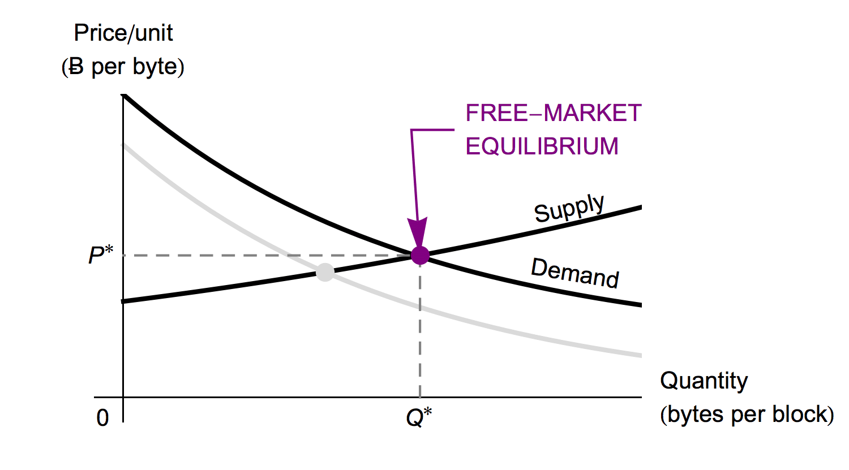
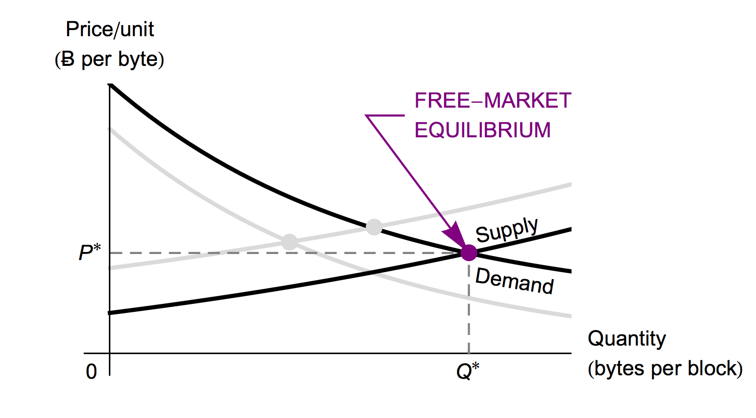
The Law of Supply Does Apply to Block Space
A Fee Market Exists Without a Block Size Limit!

Slide 13
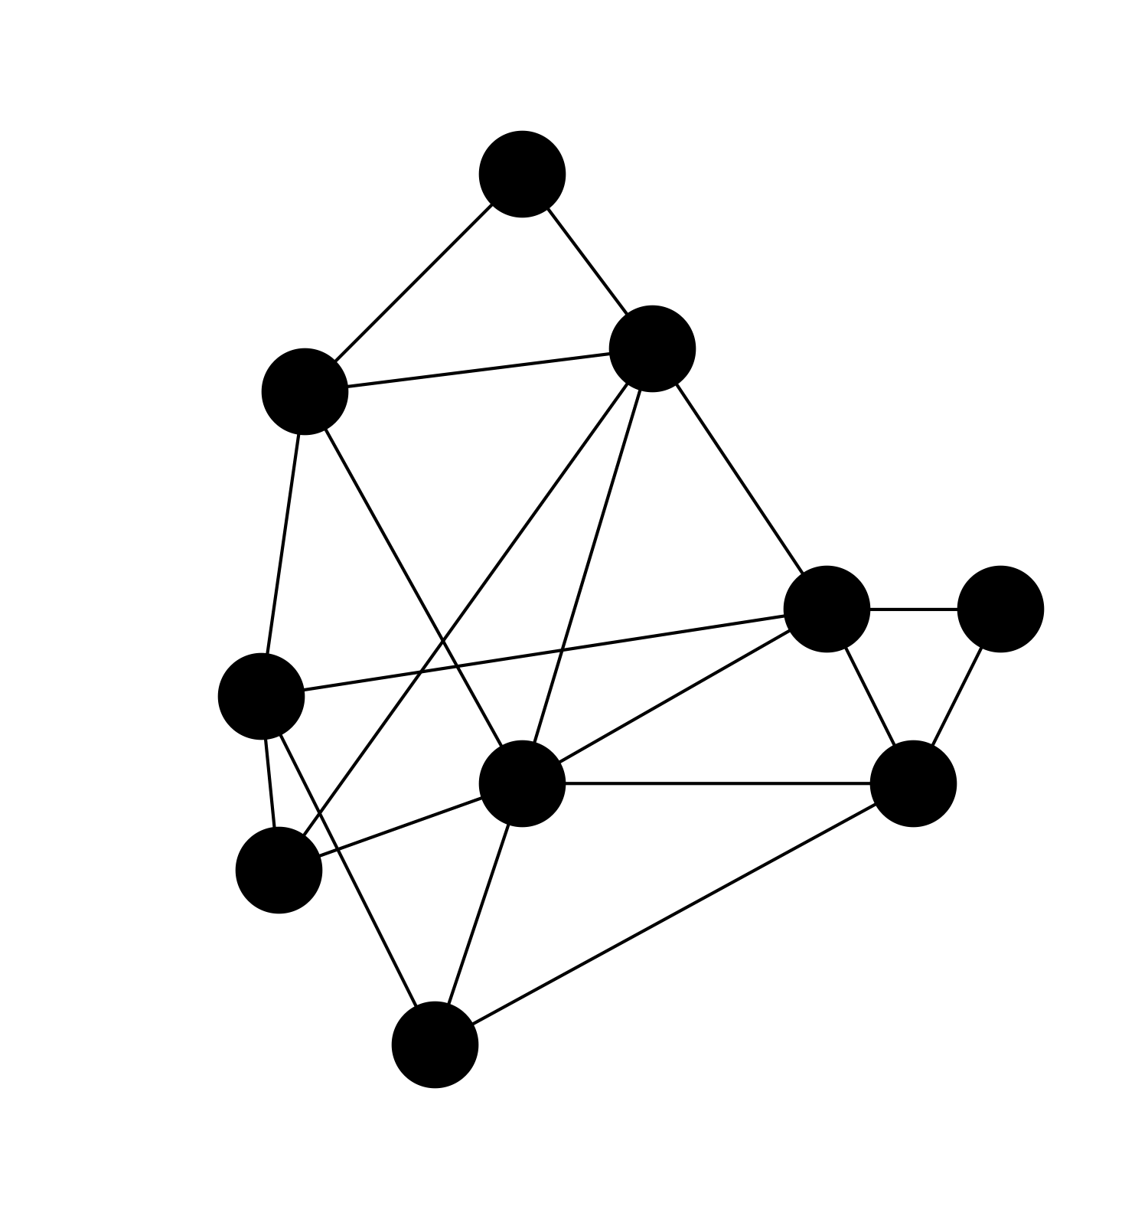
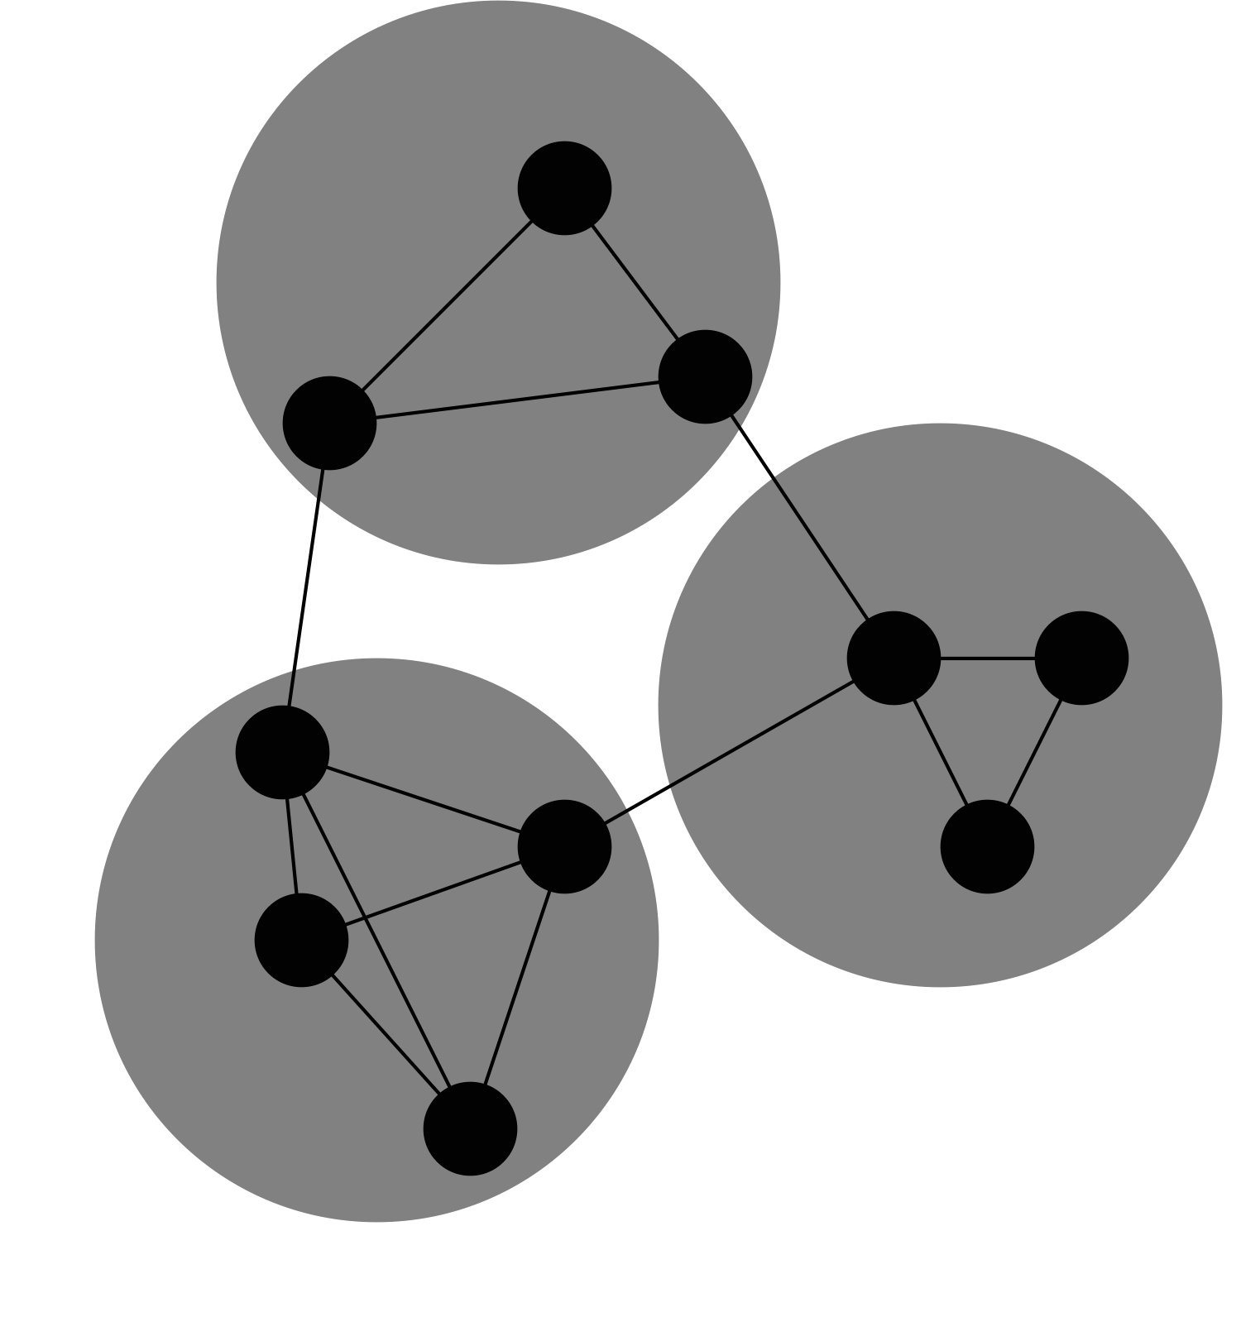
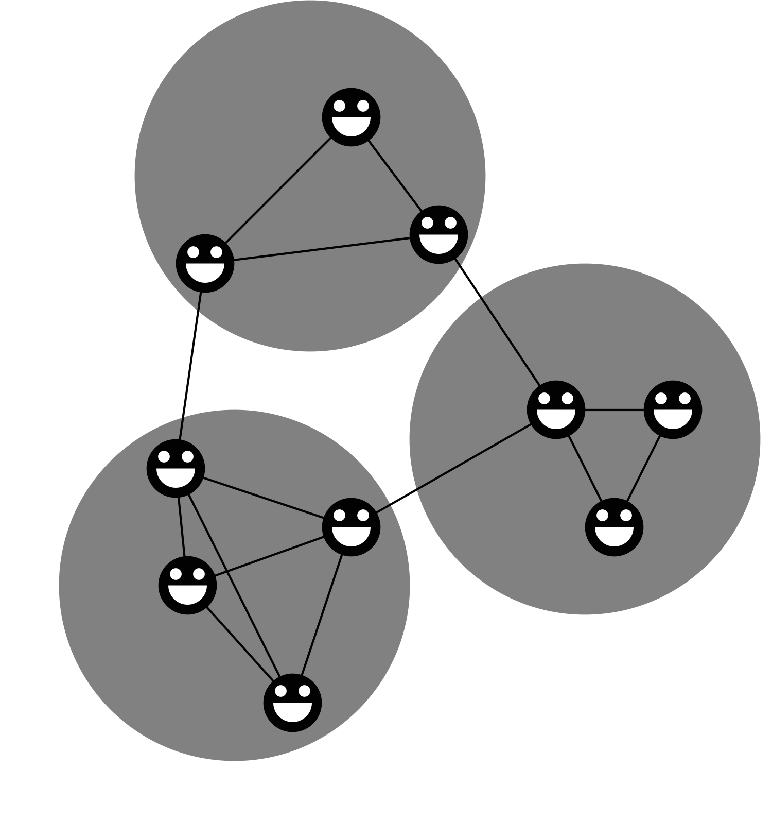
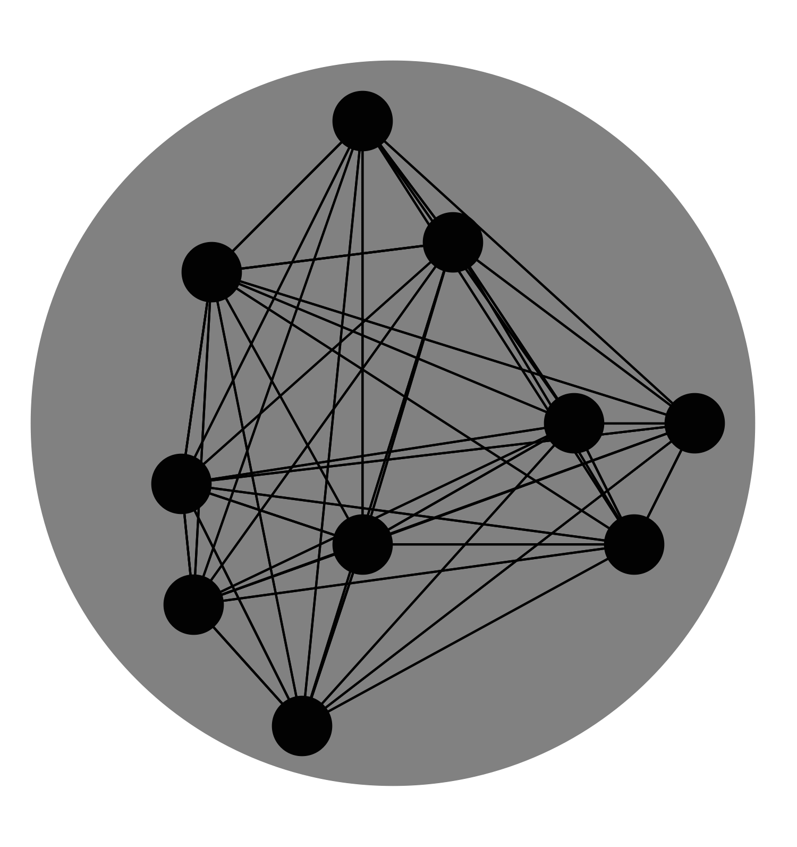
Objections
What if a group of miners decides everyone’s block contents beforehand?
Yes: that’s a mining pool
Still need to transmit block solutions between pools
Last provisio: one big pool

Slide 14
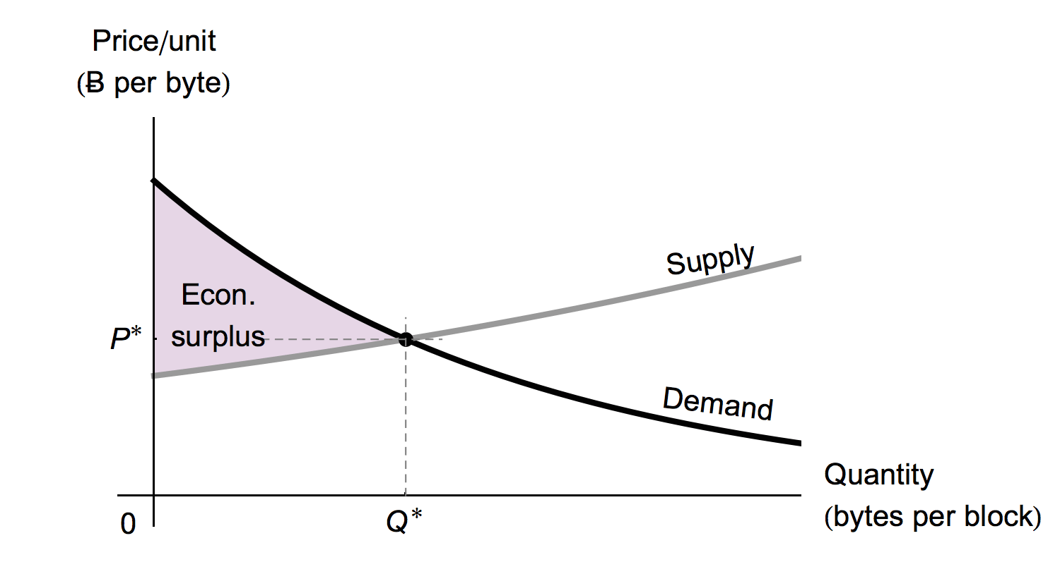
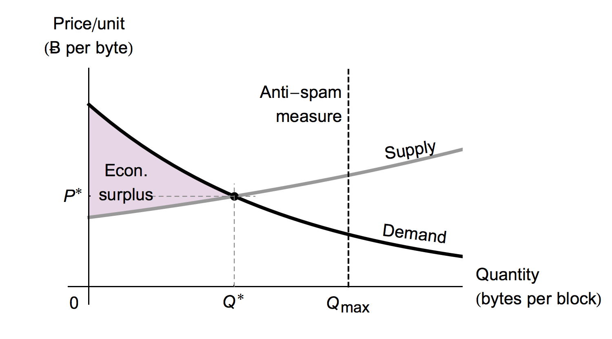
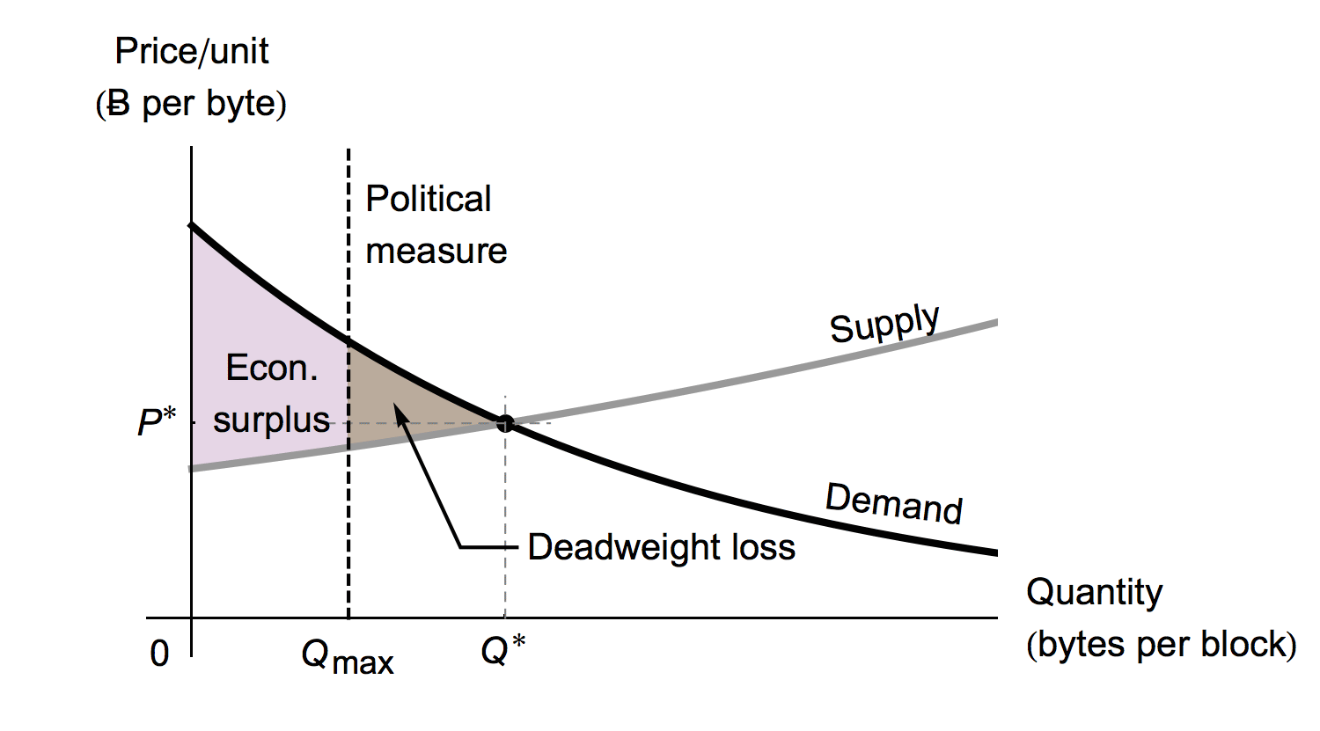
Do We Want a Block Size Limit? (Anti-spam vs. Political Production Quotas)
Is there a negative externality?
If so, can a production quota be enforced?

Slide 15
How Could a Group Enforce a Production Quota Against the Will of the Market?

Slide 16
How Could a Group Enforce a Production Quota Against the Will of the Market?
Follow the playbook of other command and control regimes: Censor people who speak out against the quota

Slide 18
How Could a Group Enforce a Production Quota Against the Will of the Market?
Censor views promoting a removal of the quota
Tighten their grip only to see nodes slip through their fingers

Slide 19
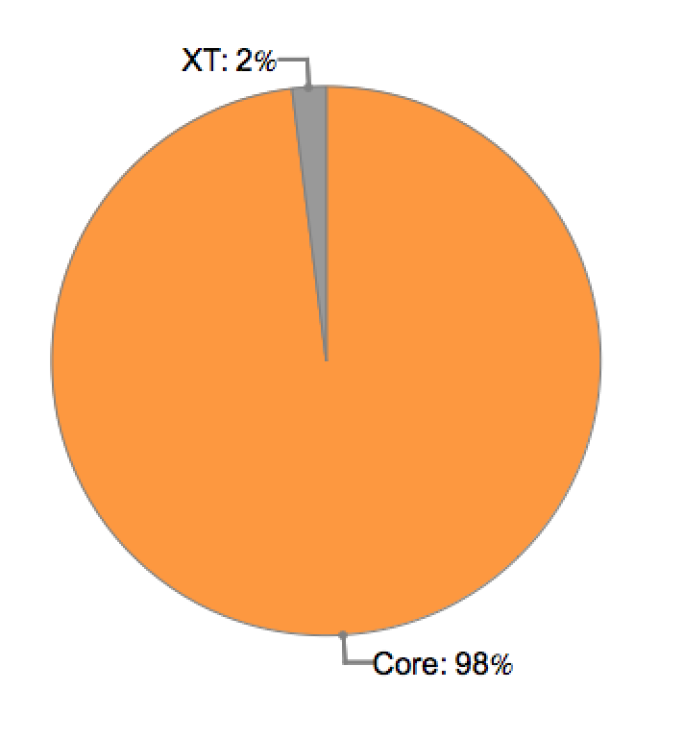
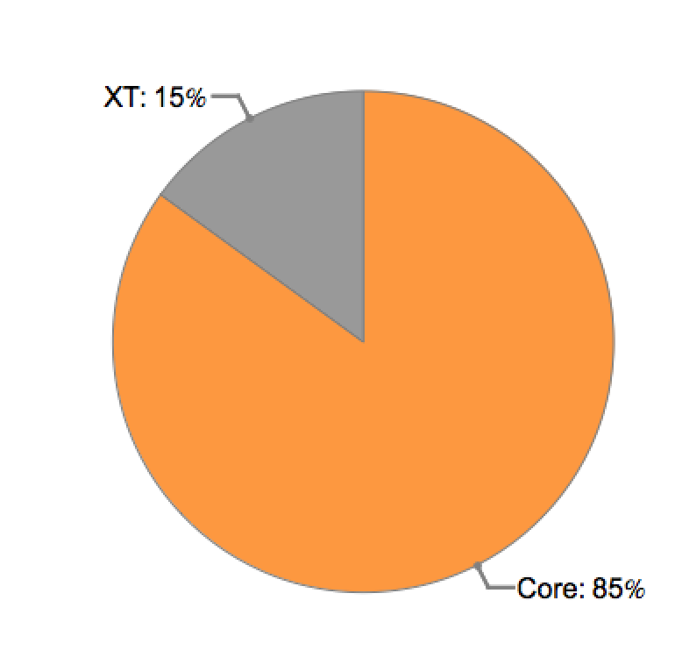
Nodes Migrate to a Solution without a Production Quota
15 August 2015
30 August 2015

Slide 20
How Could a Group Enforce a Production Quota Against the Will of the Market?
Censor views promoting a removal of the quota
Tighten their grip only to see nodes slip through their fingers
Attack any infrastructure that attempts to lift the production quota

Slide 22
In the end, I believe the production quota would fail
Bitcoin will break down dams erected by special interest groups attempting to block the stream of transactions.

Slide 25
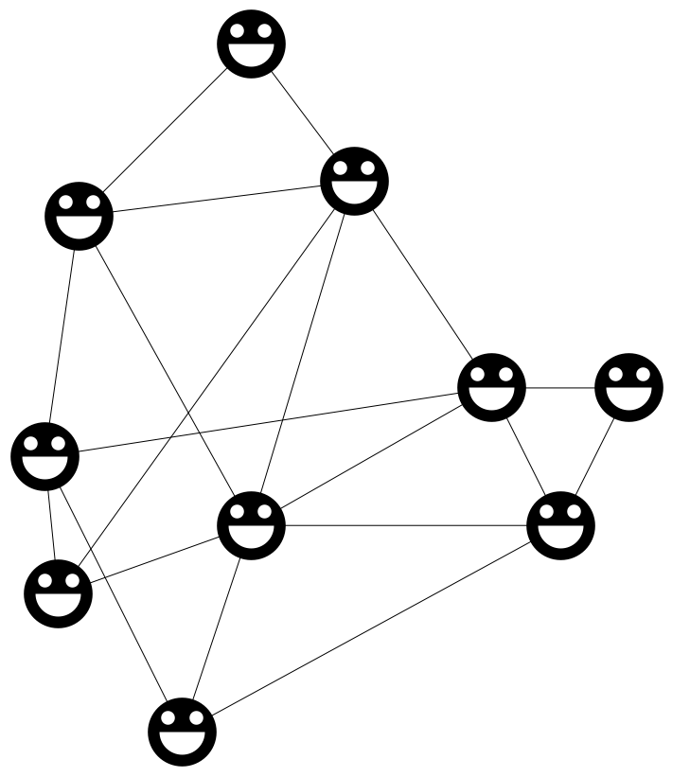
Thank you!

